Slide 1

Signify Products Reminder for Q2 2026

Slide 2

Philips LED Lamps main drivers

Slide 3
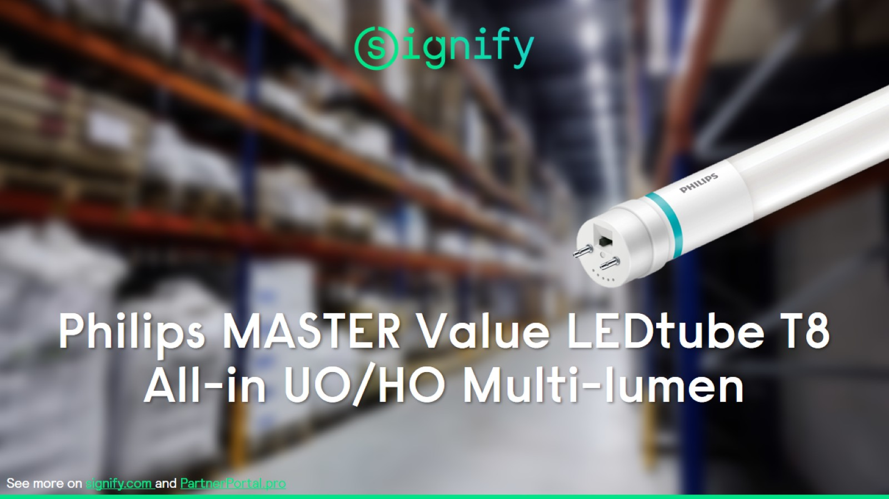

Slide 4
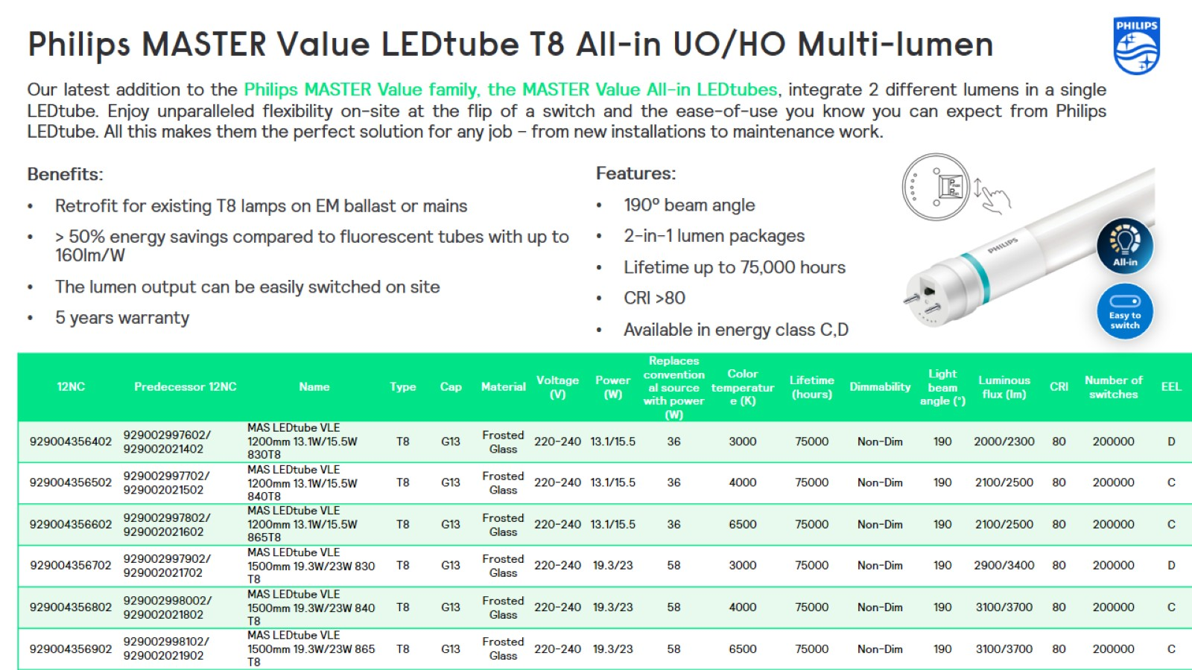
Philips MASTER Value LEDtube T8 All-in UO/HO Multi-lumen

Slide 5
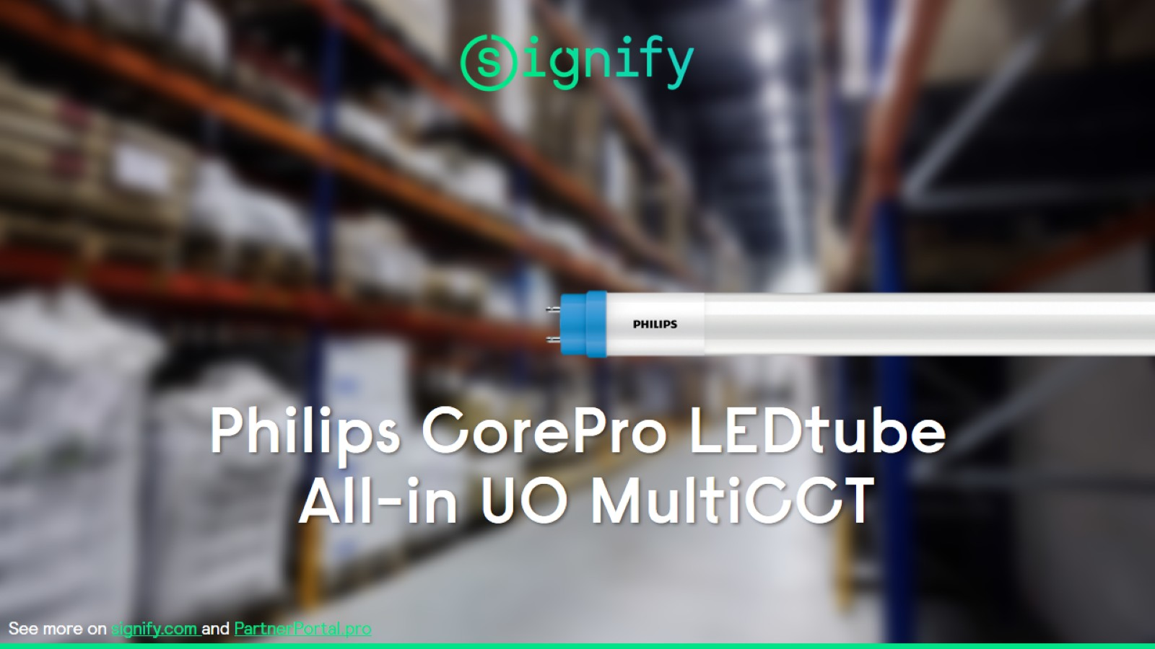

Slide 6
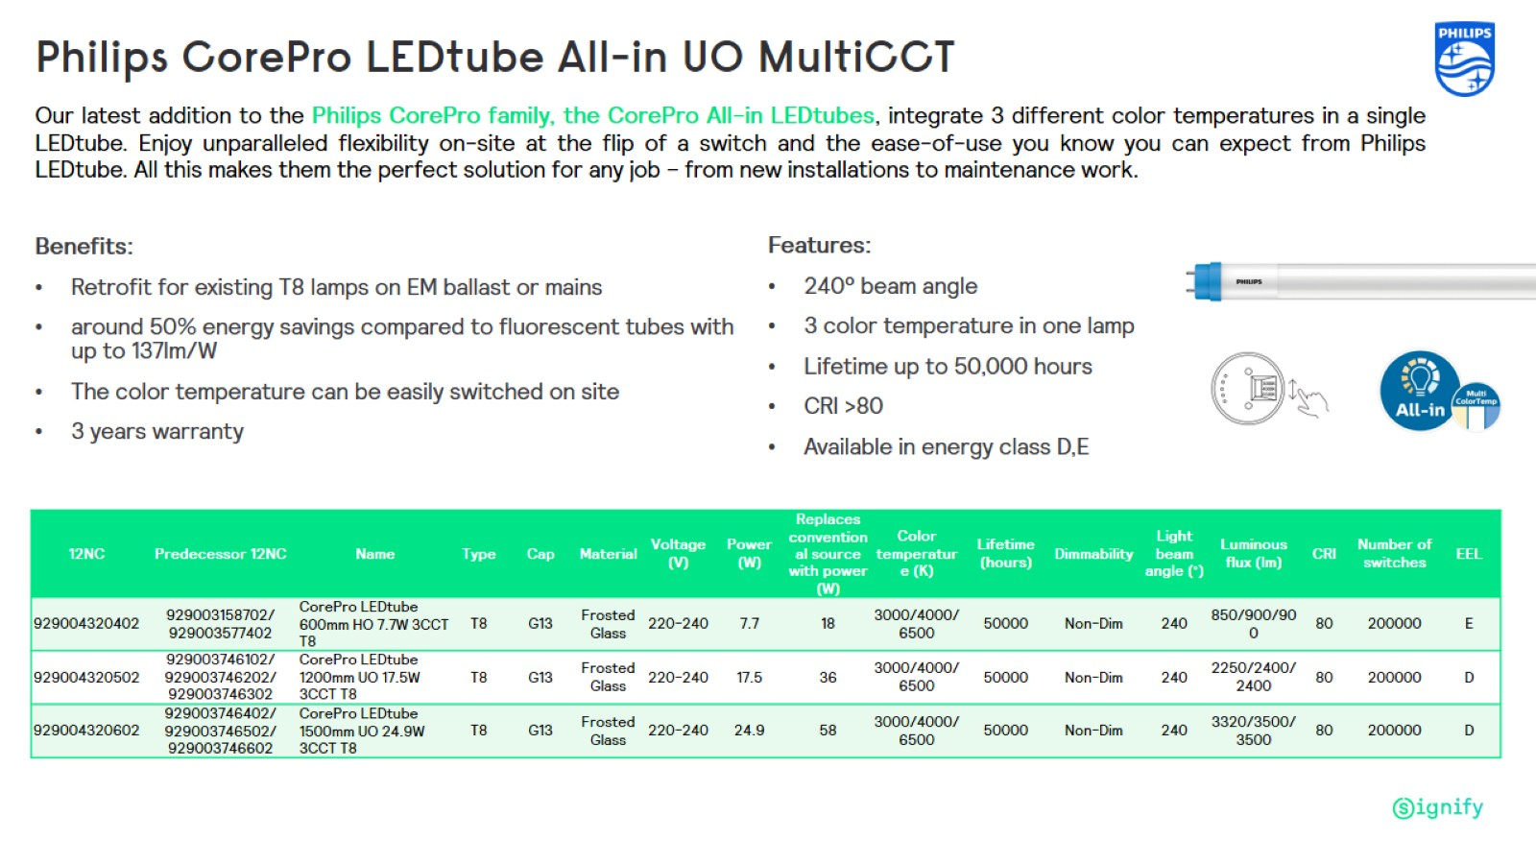
Philips CorePro LEDtube All-in UO MultiCCT

Slide 7
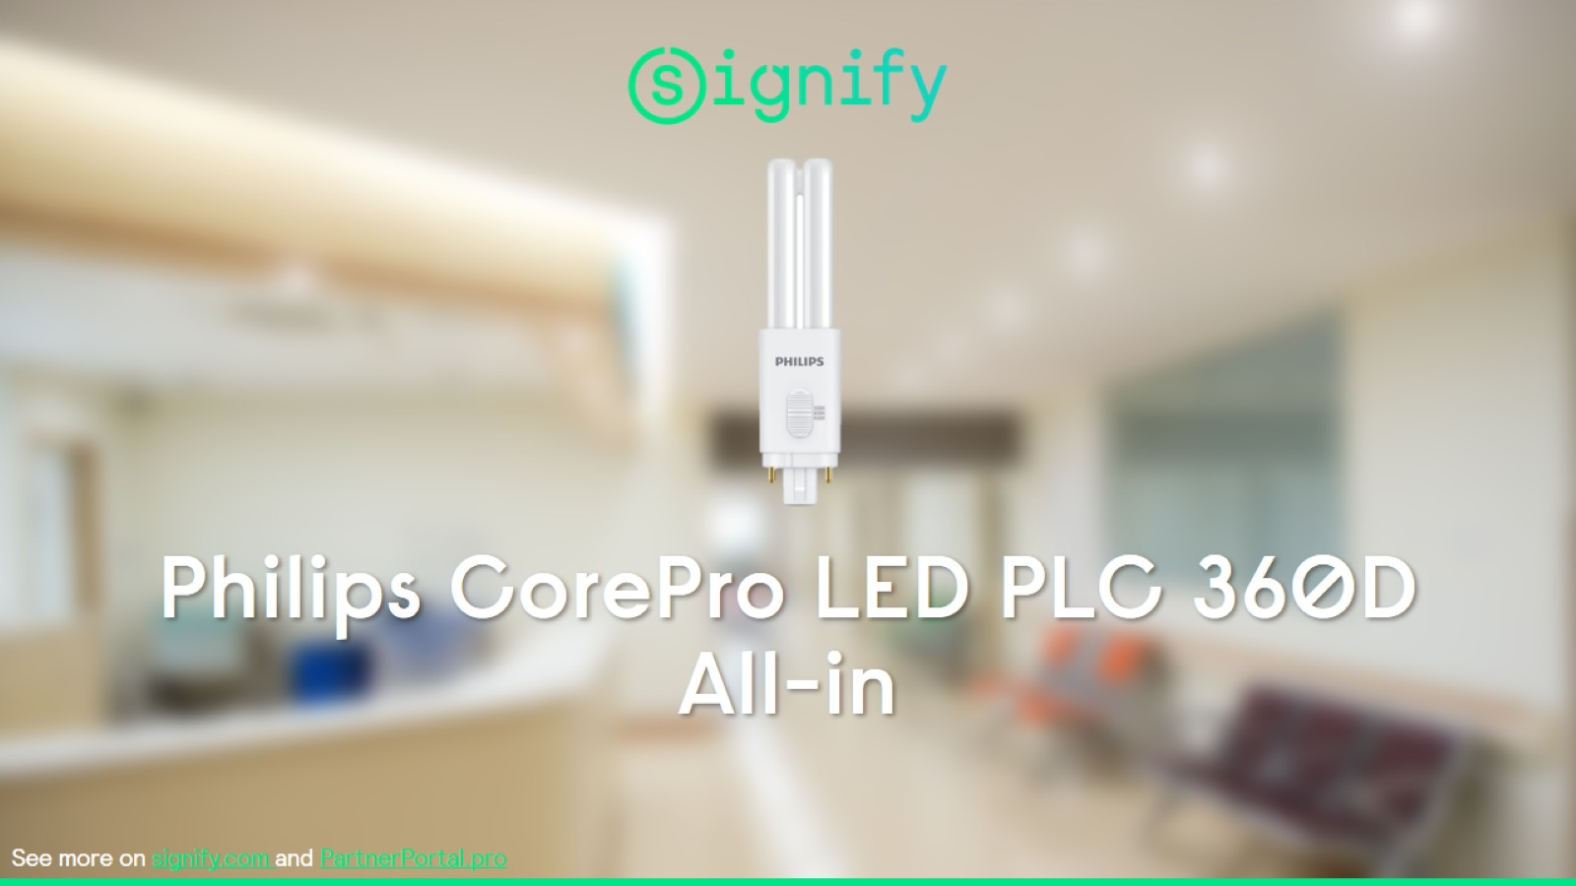

Slide 8
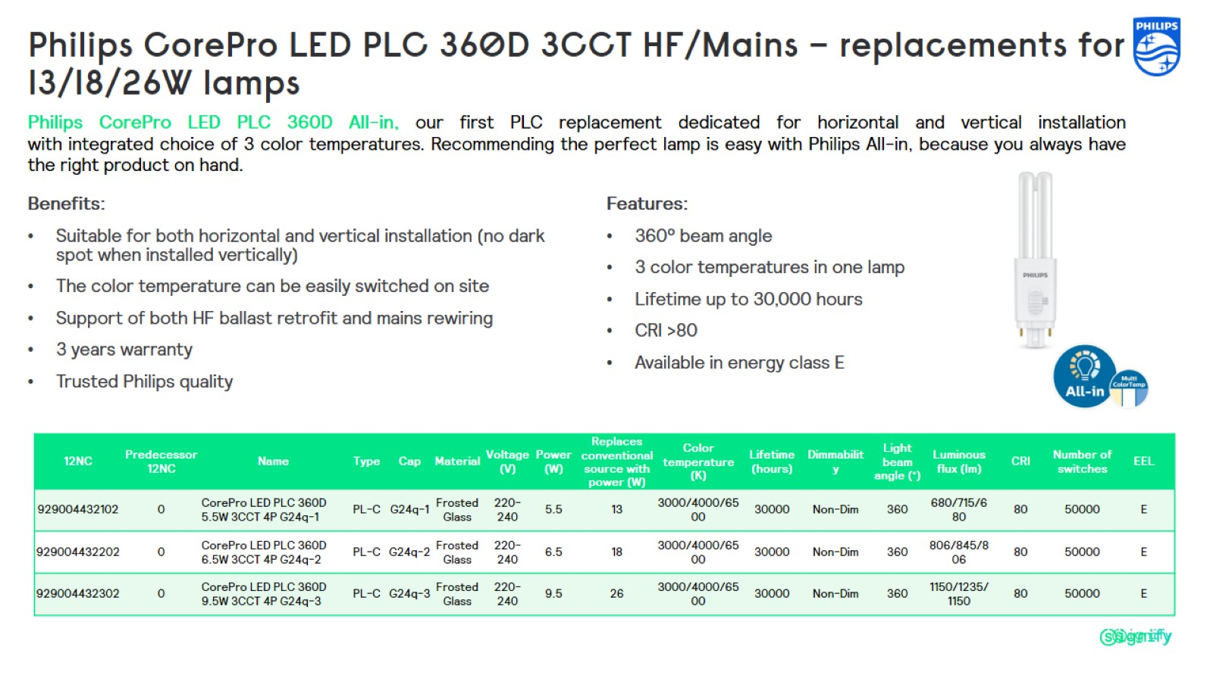
Philips CorePro LED PLC 360D 3CCT HF/Mains – replacements for 13/18/26W lamps

Slide 9

Philips Ledinaire main drivers

Slide 10
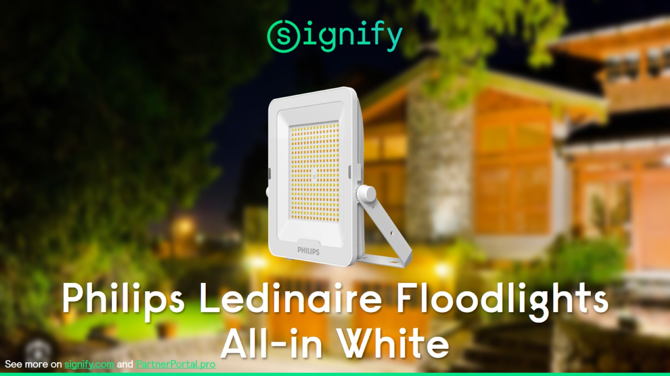
Philips Ledinaire Floodlights All-in White

Slide 11
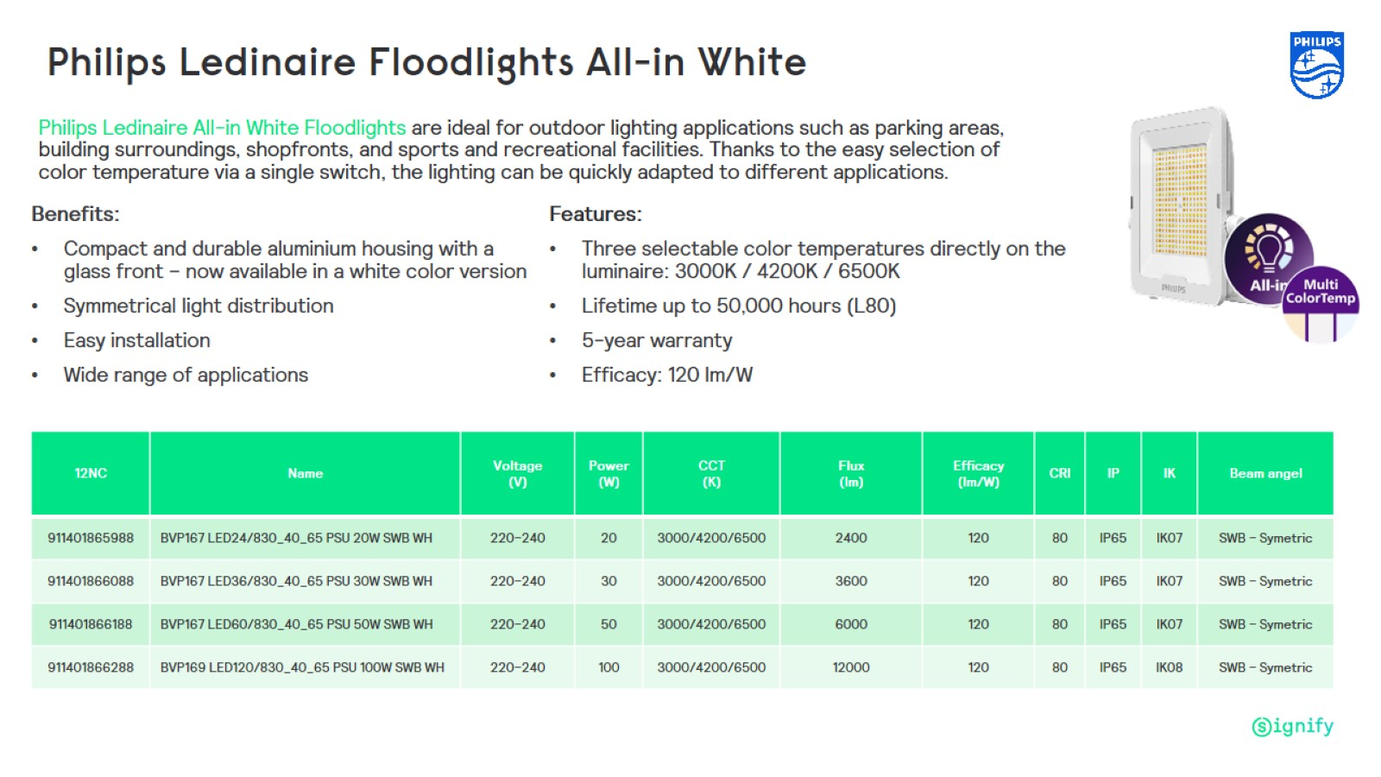
Philips Ledinaire Floodlights All-in White

Slide 12

Philips CoreLine main drivers

Slide 13
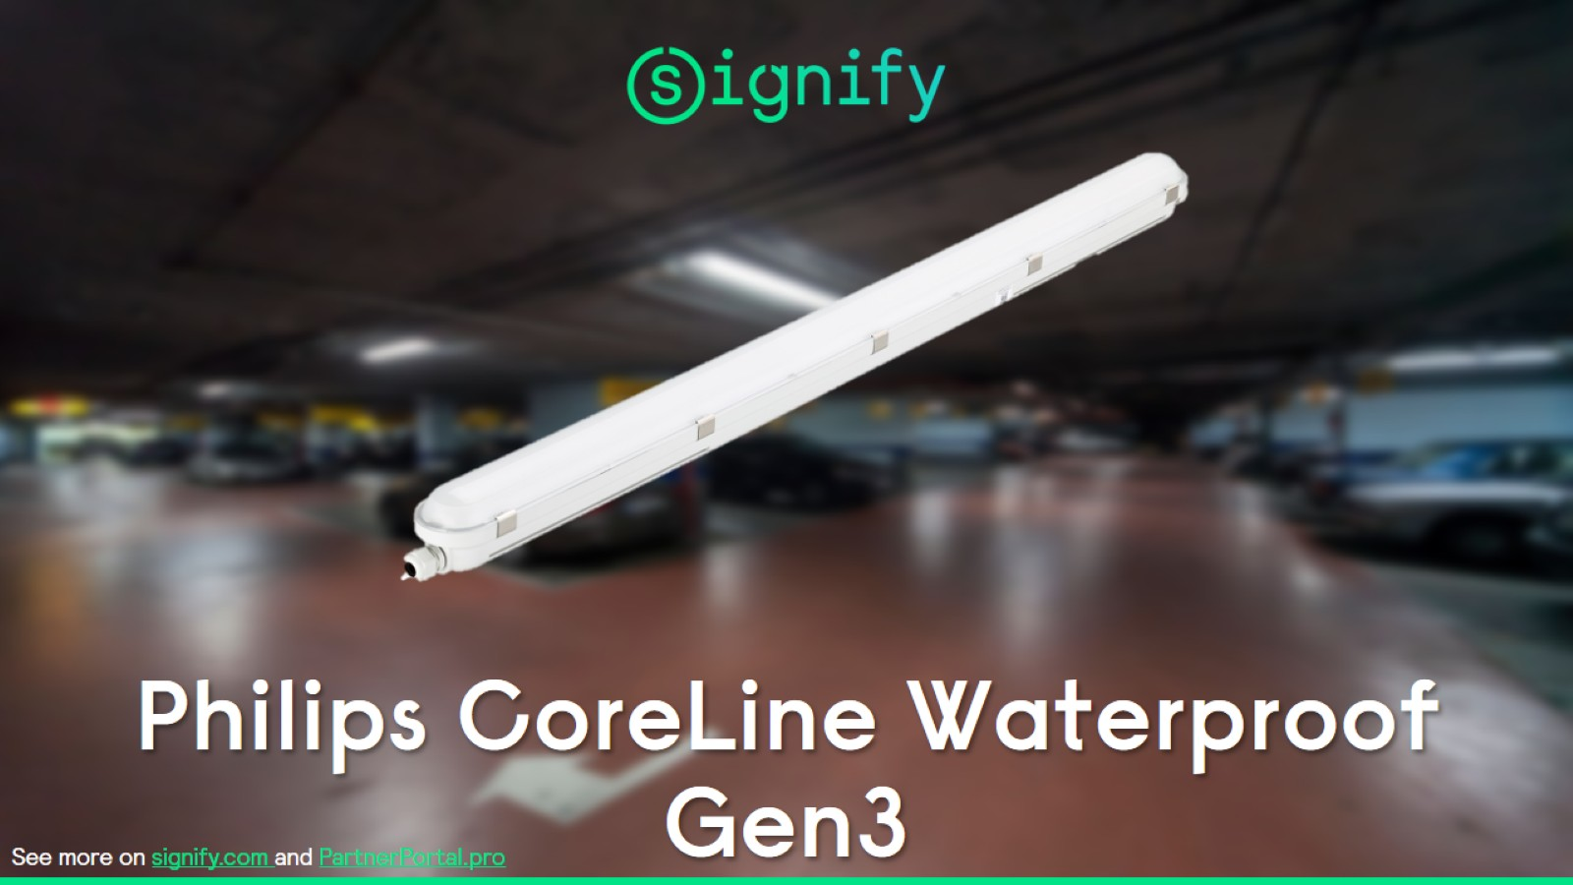
Philips CoreLine Waterproof Gen3

Slide 14
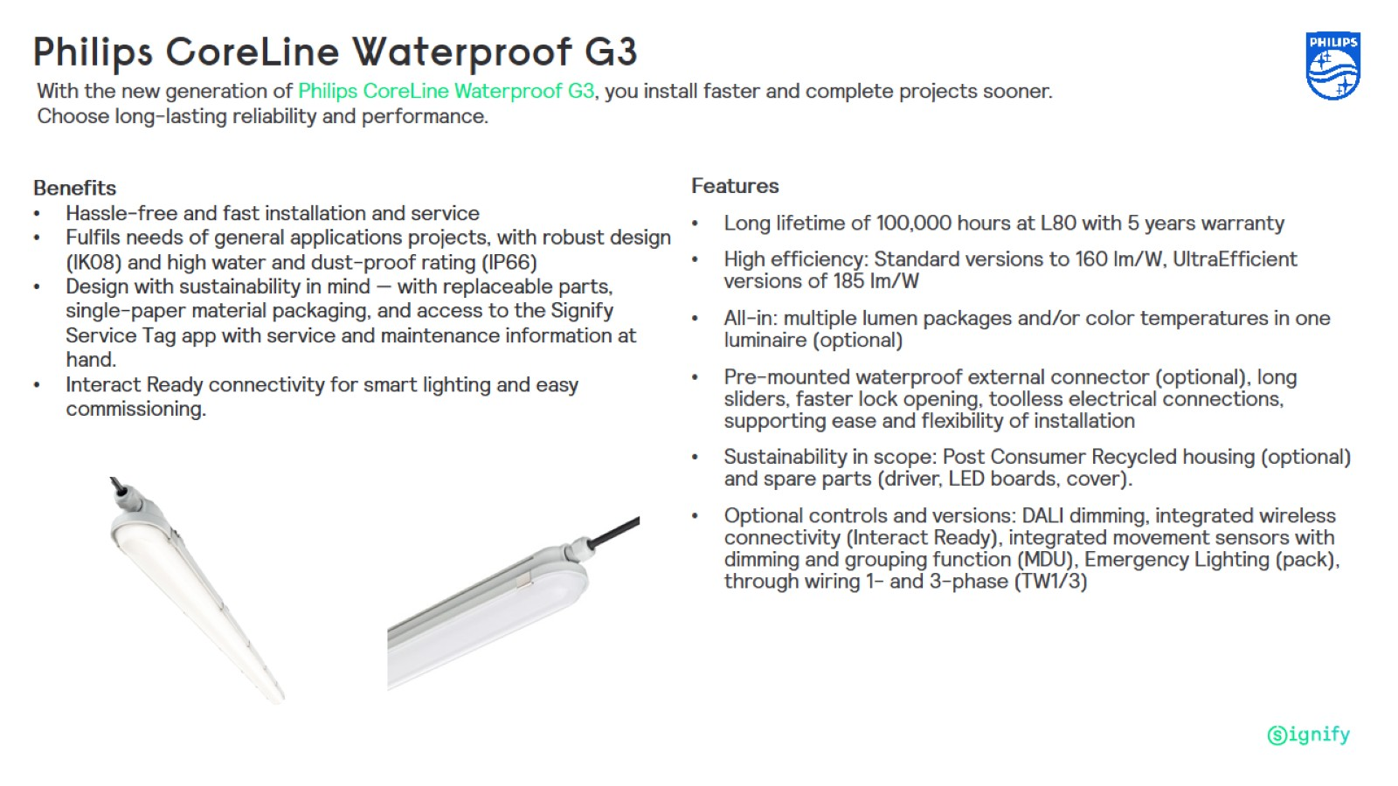
Philips CoreLine Waterproof G3

Slide 15
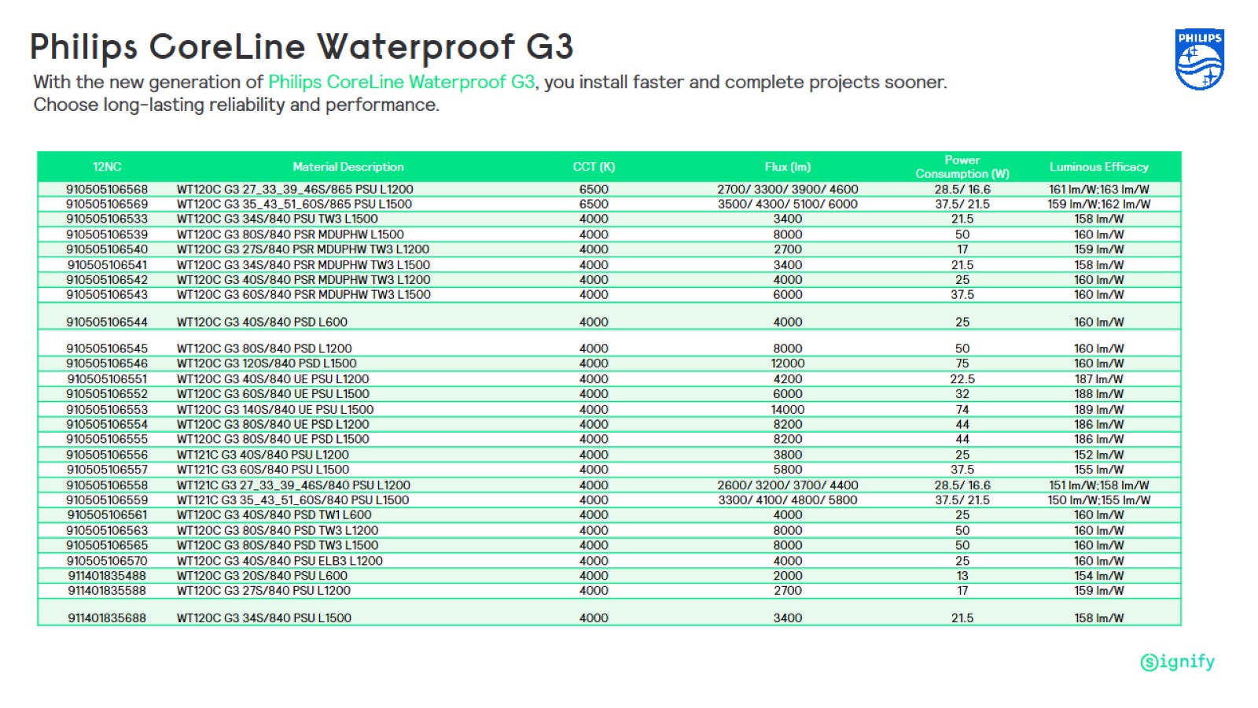

Slide 16
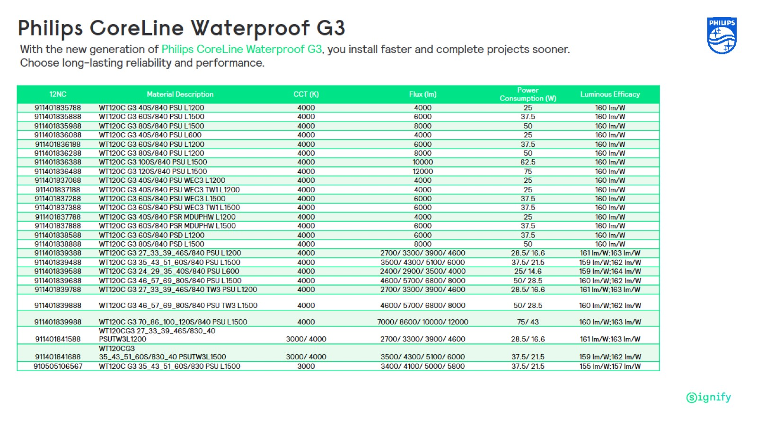

Slide 17
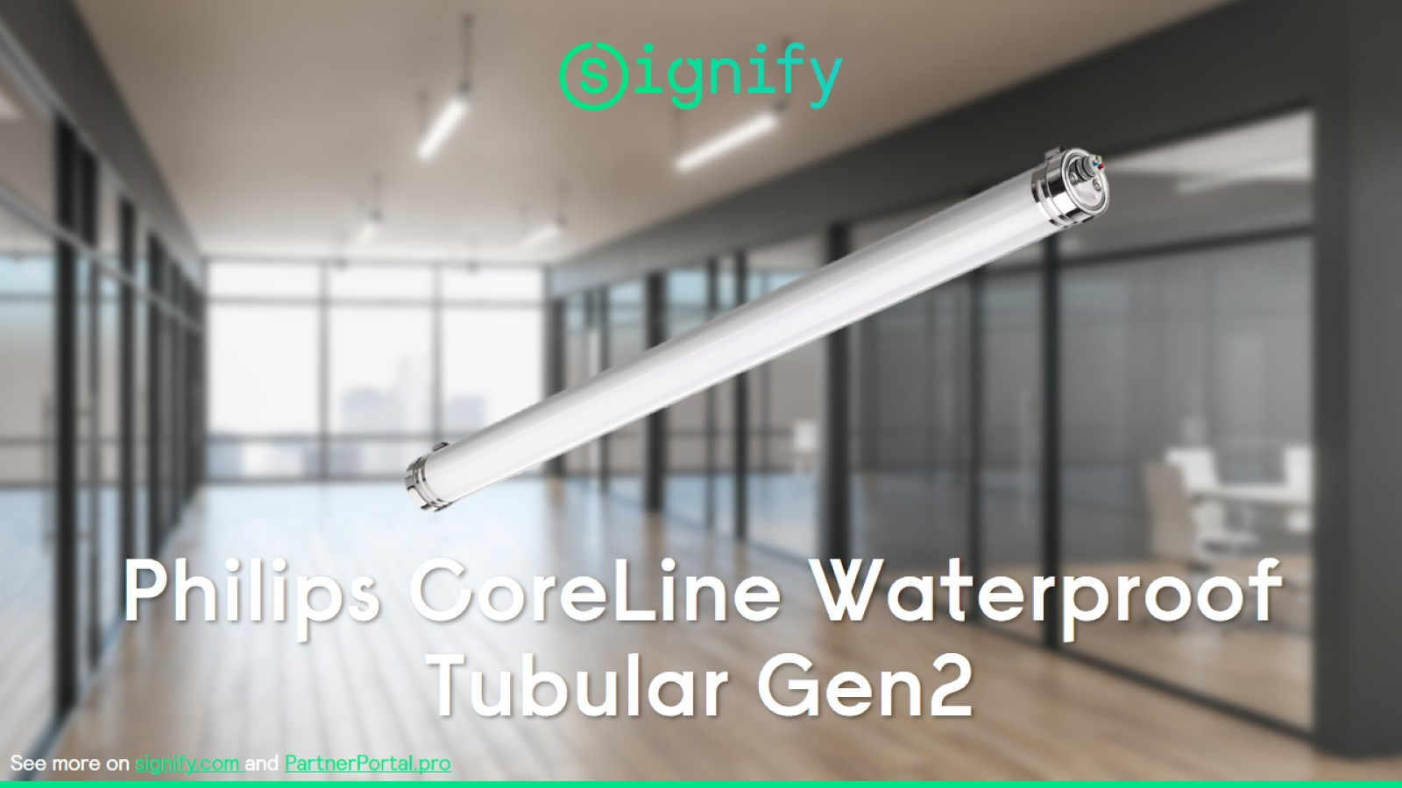
Philips CoreLine Waterproof Tubular Gen2

Slide 18
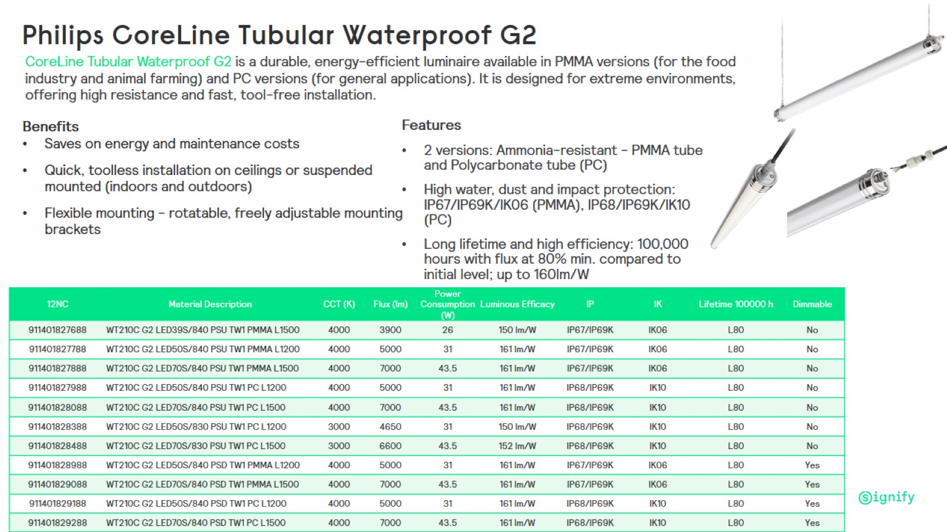
Philips CoreLine Tubular Waterproof G2

Slide 19


Slide 20


Slide 21
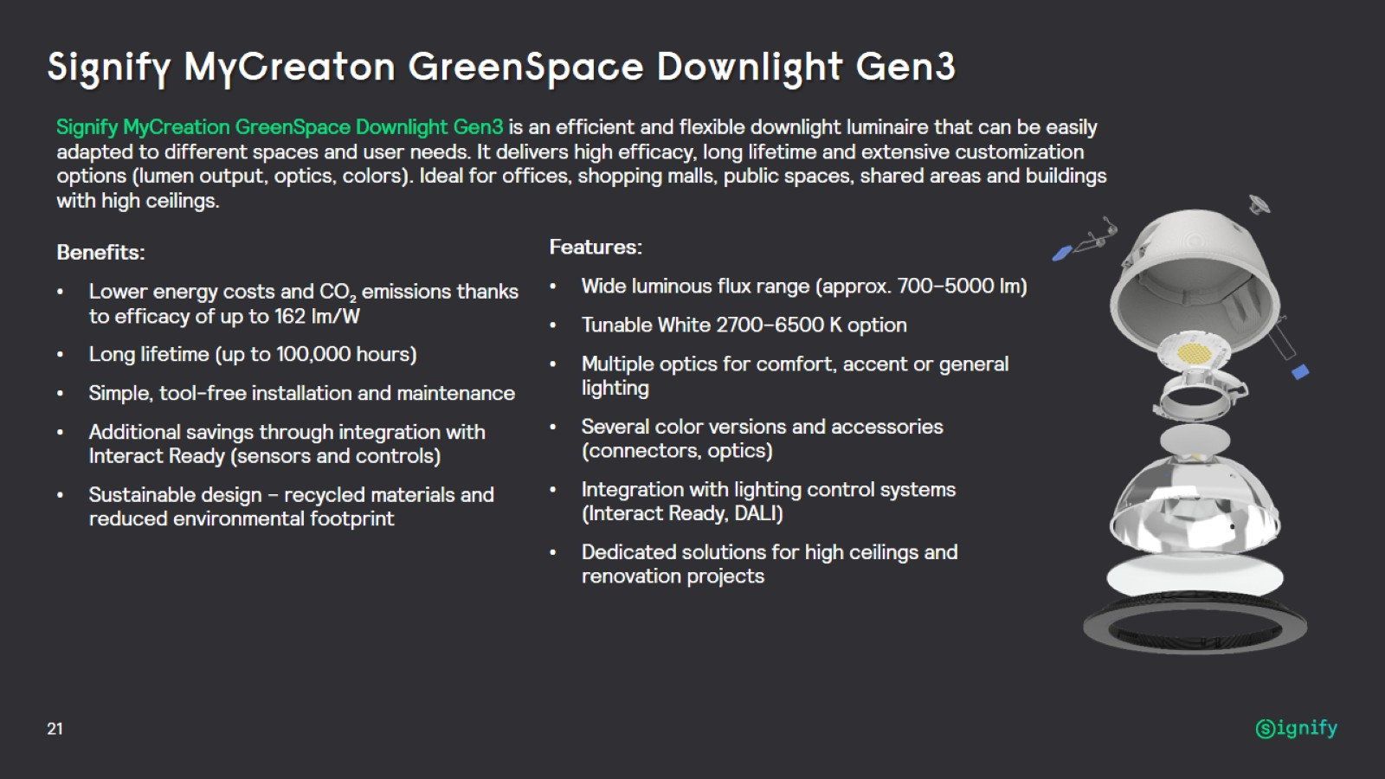
Signify MyCreaton GreenSpace Downlight Gen3

Slide 22


Slide 23
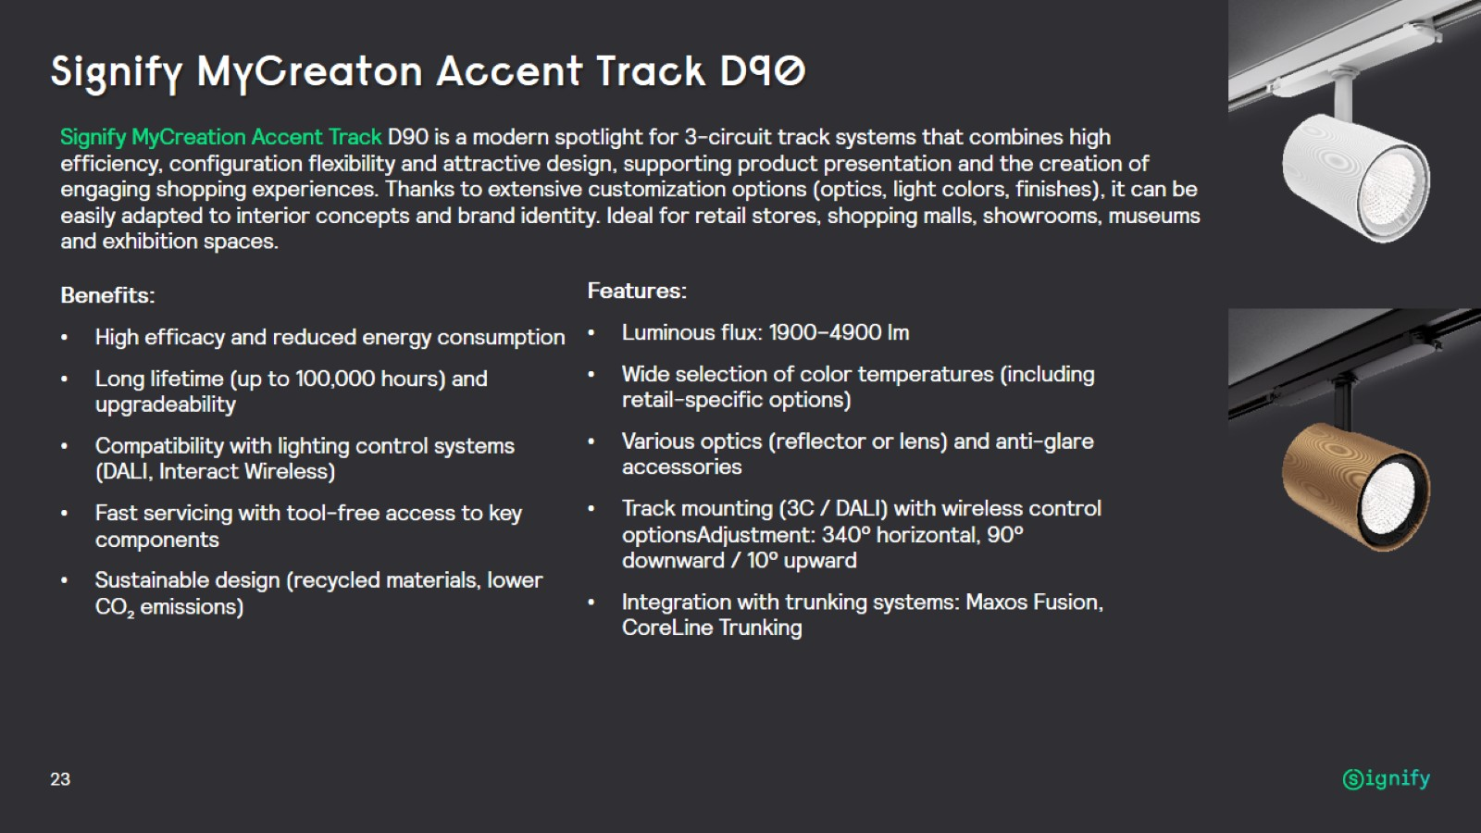
Signify MyCreaton Accent Track D90

Slide 24
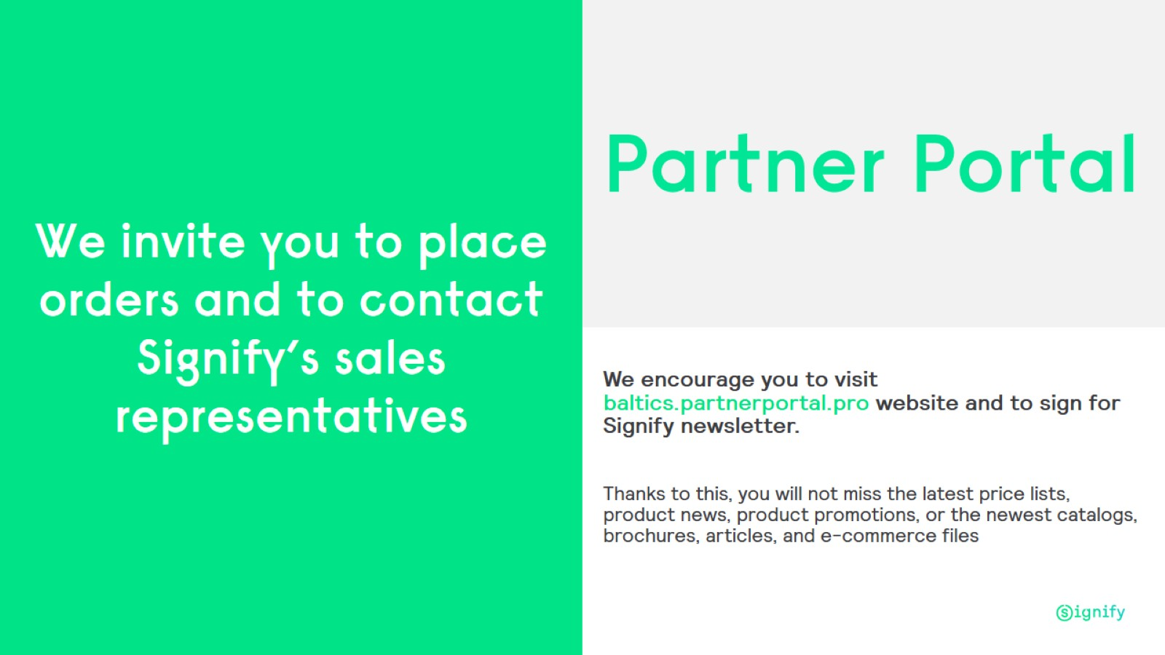

Slide 25


